Slide 1

Book Review Rating Prediction
By Thomas Dupuy

Slide 2

INTRODUCTION
Predict the star rating of a book review, out of 5, given the text portion of the review. All reviews are taken from goodreads.com user reviews and selected from a couple long book series. I picked the longest series I knew, The Horus Heresy, a 54-book series followed by a 10-book subseries.

Slide 3

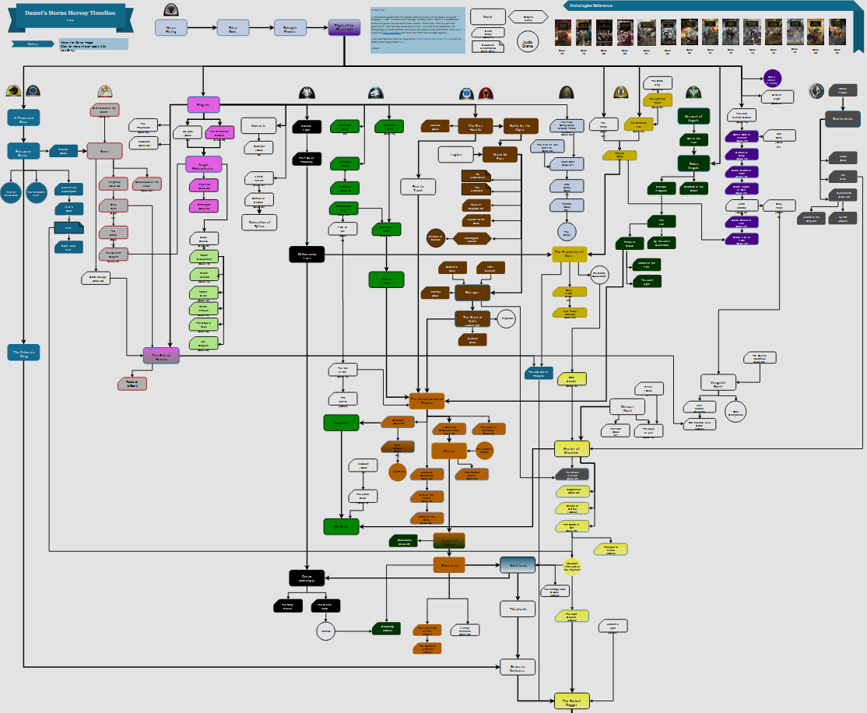
TIMELINE OF A 54-NOVEL SERIES

Slide 4
WEB SCRAPING USING BEAUTIFUL SOUP
HTML REQUEST
Request HTML from the URL of the book series
BOOKS
Retrive all books in the series through scraping
REVIEWS
Retrive reviews by requesting & scarping each book’s page
DATA FRAME
Store book, comment, and rating for each review and save

Slide 5

1,952
Reviews were collected into a CSV file

Slide 6
PREPROCESSING
1
2
3
4
HYPER LINKS
PUCTUATION
LOWER CASE
STOP WORDS
Any reviews with a hyperlink, usually to a blog, were not considered
All punctuation was removed from the comments
Comments were changed to be fully lower case
English stop words were removed from the comments
(this was reverted)

Slide 7
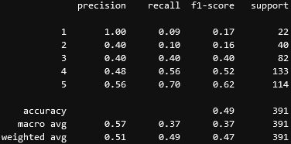
MODEL & RESULTS
TFIDF Vectorizer
RESULTS
Linear SVC
TFIDF vector creation extracting both unigrams and bigrams and almost reaching feature maximum
Despite playing around with parameters the best accuracy that could be reached was around 50%
Linear Support Vector Machine with balanced class weight to account for obvious class imbalance

Slide 8

CONCLUSION
I was somewhat dissapointed again with my testing results but I came to realize book reviews are very subjective and some people will love a book and only give it a 4 because its not “perfect”. The class weight was also so incredibly squed that even when balancing, it wouldn’t be perfect. After some generic testing, I found the model to do a good job.

Slide 9

THANKS!
Do you have any questions?

